Slide 1
Cobber E-Store PROPOSAL
By: Amira, Oriana, Elias

Slide 2
Overview
Introduction
Work performed so far
What has gone well
Challenges faced
Plan for remaining
Project Demo

Slide 3
Introduction
Simulating an E-store Cobber website

Slide 4
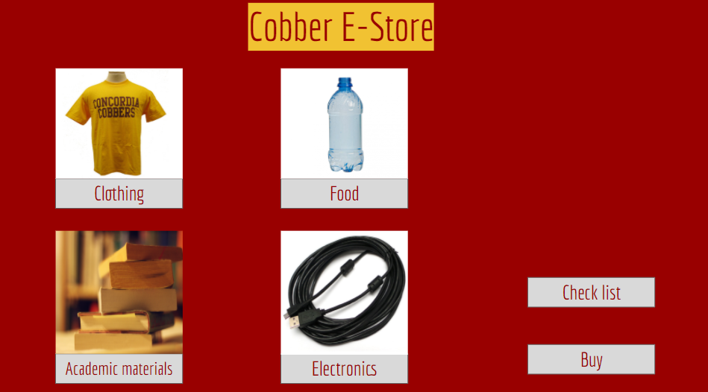
Work performed so far
Website Design
Figured out main structures

Slide 5
What has gone well
Teamwork
Communication
Overall Project design

Slide 6
Challenges
Connecting different J-frames together
Back/Forward Buttons

Slide 7
Plan for remaining work
Improve the windows
Back/Forward buttons
Payment
Add buttons
Connect multiple Jframes
Able to go back and forth between Jframes
Cash payment

Slide 8
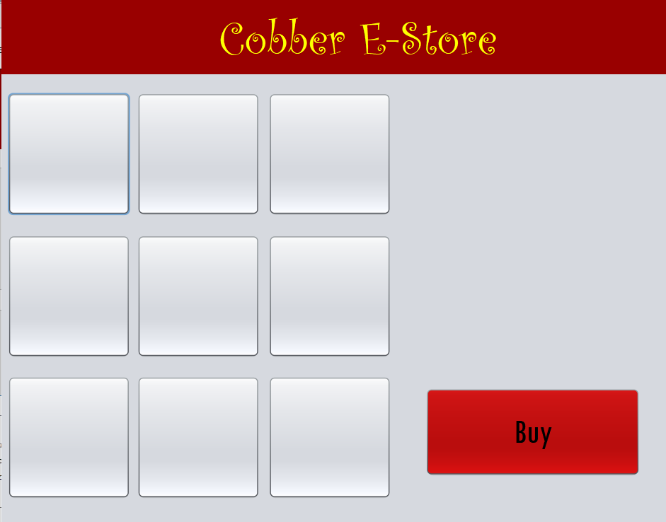
Project Demo

Slide 9
Conclusion
Cobber E-Store

